Slide 1
Occupational Exposure Limits (OELs) and Bolus Exposures
SRA –Arlington,VA Dec 9, 2015
Michael “Mike” Jayjock, PhD, CIH
http://jayjock-associates.com/
http://jayjock-associates.blogspot.com/

Slide 2
Content
Standard and traditional matching of exposure duration(s) to 8 hour (TLV-TWA), 15 minute (TLV-STEL) or peak Ceiling or “TLV-C” OELs
Mismatching 8 hour TWAs to Bolus Exposure
What we might be missing
DMNA as an Example
Using C,t Dose-Response Curves and 8 hour TWA to estimate working short term Bolus OELs

Slide 3
Most IHs Know How to Do It
Exposures that occur and are measured over at least a 30 to 60 minute period typically get compared to 8 hour TWA OELs
Those that occur and are measured over a period of minutes (to about 30 minutes) get compared to a 15 minute STEL (if one exists)
High peak exposures that are measured get comparted to Ceiling Limits (“C”) (if one exists) or the ACGIH Excursion Limit

Slide 4
ACGIH Excursion Limits as a Default or Fall-Back Position
“Excursions in worker exposure levels may exceed 3 times the TLV-TWA for not more that a total of 30 minutes during a workday, and under no circumstances should they exceed 5 times the TLV-TWA, provided that the [8 hour] TLV-TWA is not exceeded.”
Note: We will see another, more precise, and I believe more useful, methodology proposed by Tony Havics later in this presentation.

Slide 5
A Classic Case of Misalignment
Focusing on 8 hour time-weighted average (TWA) exposure when exposures are happening in much shorter time frames (i.e., Bolus exposure).
Reason(s) why it has happened:
Vast majority of ACGIH TLVs are 8 hour TWA with relatively few STELs and even fewer Cs
It is “analytically” and often logistically, very challenging to identify, detect and quantify bolus exposures (It is analogous to being much easier to look for your lost keys under the street lamp)

Slide 6
Using 8 Hour TWA OELs could Fail you Miserably during BOLUS events
Bolus events
Massive concentrations delivered over very short (seconds to minutes) time frame. Examples:
Spill of highly volatile liquid
Release of pressurized gas
Head space emissions and leaks from highly volatile chemicals or gases from large tanks

Slide 7
Definition of a Risk Assessment Failure
You have the reality of workers who are sick or injured from workplace inhalation exposure
A measurement and assessment scheme that does NOT and, perhaps, CANNOT detect any significant exposure for these workers to any agent.

Slide 8
Bolus vs 8 hour TWA OEL Exposure
Scenarios 1 and 2 below illustrate the potential concentration difference between a time-weighted average (Scenario 1) and bolus exposure (Scenario 2).
In Scenario 1, the breathing zone concentration of the chemical is relatively constant throughout an eight hour shift and results in a measured value 7 ppm after repeated sampling as an eight hour time-weighted average (TWA).
In Scenario 2, the worker receives essentially no exposure for most of the period but a single bolus exposure to the compound that lasts two minutes. This also results in an integrated 8 hour TWA exposure of 7 ppm.

Slide 9
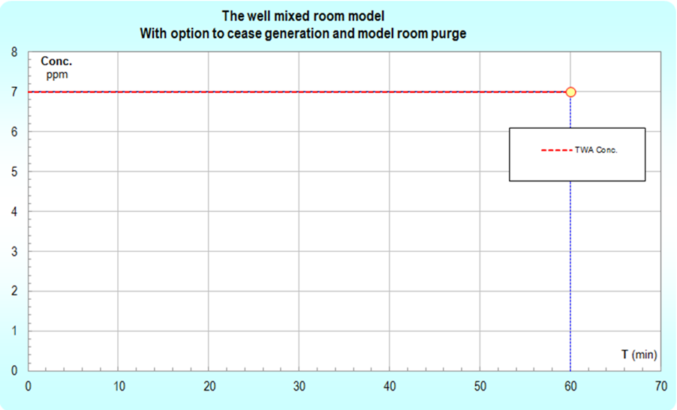
Scenario 1 – Steady 8 hour release and exposure

Slide 10
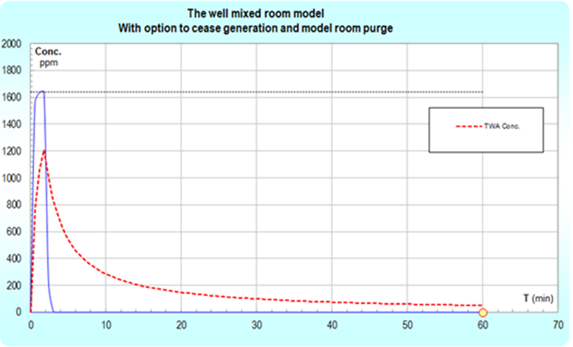
Scenario 2 – 2 minute Bolus release and breathing zone exposure
Note: The graph only extents 60 minutes to better show the peak

Slide 11
Are these Different Exposures?
Both are measured as 7 ppm as an 8 hour OEL.
Peak in Scenario 1 is 7 ppm
Peak in Scenario 2 is 1600 ppm!
Depending on the chemical, the exposure in Scenario 2 could easily overwhelm the body’s defense and cause a serious toxicological event especially for an irritant.
What if the entire 7 ppm 8 hour TWA exposure was delivered in 10 seconds (a few breaths)? What would the peak exposure be? !

Slide 12
DMNA or Nitrosamine Example
DMNA is a “classic” chronic toxicant as a potent carcinogen.
Could it also cause serious local tissue response (respiratory irritation) from a bolus exposure?
That is, should we be worried about potential short term bolus exposures to BZ concentrations of DMNA that are multiples of a working 8 hour OEL?

Slide 13
Scientific and Technical Assessment Report on Nitrosamines. EPA-600/6-77-001. 1/2
To quote this report:
“The potency of N-nitroso compounds in causing acute tissue injury and death varies considerably (Table 3-1).” Table 3-1 clearly shows that dimethyl [DMNA] and diethyl nitrosamine are considered the most reactive compounds in the nitrosamine series and to quote the report, as the most “reactive compounds produce hemorrhagic destructive lesions at the site of contact…” [emphasis added] The report goes on further in the same paragraph: “Spills have led to irritation of the eyes, lungs and skin.”

Slide 14
Scientific and Technical Assessment Report on Nitrosamines. EPA-600/6-77-001. 2/2
In other words the hepatotoxicity (ability to cause cancer) is so “striking” that any study of the acute effects has taken a “back seat”. Taken as a whole, the above information shows that contact site toxicity (severe irritation) of the respiratory tract for inhalation appears to be a clearly present reality.

Slide 15
Bolus Exposure DMNA
Consider an exposure to a concentration >40x a Working 8 hour OEL to DMNA occurring in a time frame of one or two breaths would never exceed the 8 hour OEL.
It would most likely never be detected during sampling to an 8 hour OEL.
I predict this bolus exposure could have a serious acute irritation effect on the upper respiratory tract of the person inhaling this brief-high concentration exposure.

Slide 16
Using C,t Dose Response to Set Short Term (Bolus) Exposure Limits from 8 hour TWAs
Dr. Wil ten Berge proposed the following relationship of Concentration, time and toxicity for short-term events:
(C^n)*t = K (n = 1 is Haber’s Rule)
Andrew Anthony “Tony” Havics, CIH, PE (www.ph2LLC.com) suggests considering the following expansion for this relationship:
(C^n)*(t^a) = K (a = 0 for local tissue irritants, with n (from experimental data with rodents) varying from 1 to 3). Thus, for irritants the OEL would be “flat” for all times less than 8 hours and the 8 hour TWA would equal the Ceiling exposure limit.

Slide 17
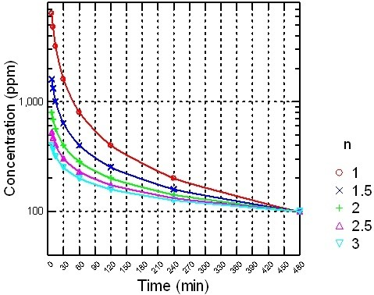
C,t Curve Sent by Tony Havics
http://jayjock-associates.blogspot.com/2015/03/short-term-or-bolus-exposure-limits.html

Slide 18
Remember
Tony’s C,t curves on the previous slide are for systemic effects including death
For irritants (a = 0) the line is flat from the 8 hour TWA to the zero averaging-time peak or Ceiling Limit

Slide 19
Recent Example of Misaligning 8 hour TWAs with Bolus Exposures
Exposure to Hanford Tank Farm workers.
http://srnl.doe.gov/documents/Hanford_TVAT_Report_2014-10-30-FINAL.pdf
“…the TVAT [Hanford Tank Vapor Assessment Team] determined that the most likely scenario was that characterization methods (e.g., use of 8-hour time-weighted averages) were inadequate. The TVAT developed a hypothesis that vapors coming out of tanks in high concentration (bolus) plumes sporadically intersected with the breathing zones of workers, resulting in brief but intense exposures to some workers.”

Slide 20
Take-Home Message
It is not appropriate to measure the average exposure over 8 hours and compare it to an 8 hour OEL when the actual exposures occur as boli
“Capturing” and measuring the short term exposure events via real time instruments or sophisticated modeling (e.g., CFD) are needed to characterize the real nature of the exposure and point to the proper time frame for any appropriate exposure limit.
Further details available at:
http://srnl.doe.gov/documents/Hanford_TVAT_Report_2014-10-30-FINAL.pdf
http://jayjock-associates.blogspot.com/2015/03/short-term-or-bolus-exposure-limits.html

Slide 21
Questions?
Please ask them here or at mjayjock@gmail.com

